Slide 1
Vague Feedback
by
Intellectual Property Owners Association
Women In IP Committee
Push Forward Subcommittee

Slide 2
Overview
What Is Vague Feedback?
Vague Feedback Is Holding Women Back
Suggestions for Evaluators
Suggestions for Those Being Evaluated
Questions

Slide 3
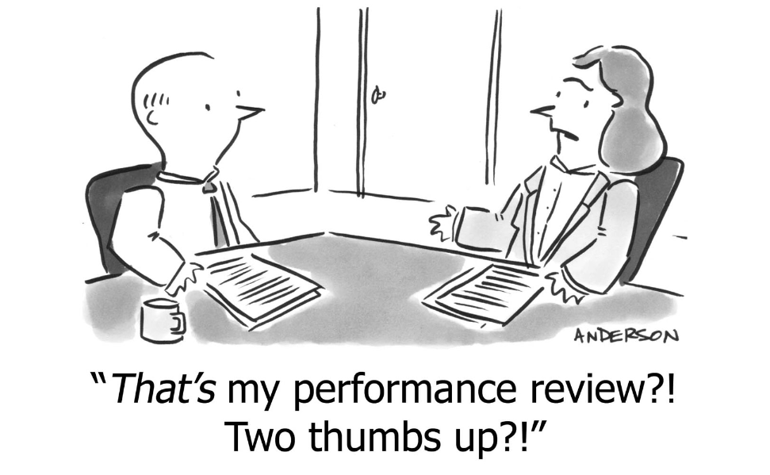
Vague Feedback
Feedback that is not tied to outcomes, but includes general statements.
Examples: “you are too aggressive” or “you had a good year”
Cartoon from: https://business.linkedin.com/talent-solutions/blog/talent-on-tap/2017/why-no-one-is-getting-the-annual-review-process-right-and-how-to-change-that

Slide 4
Vague feedback can hold women back:¹
stereotypes about women’s capabilities mean that reviewers are less likely to connect women’s contributions to business outcomes or technical expertise; and
stereotypes about women’s care-giving abilities may cause reviewers to more frequently attribute women’s accomplishments to teamwork rather than team leadership.
1. https://hbr.org/2016/04/research-vague-feedback-is-holding-women-back

Slide 5
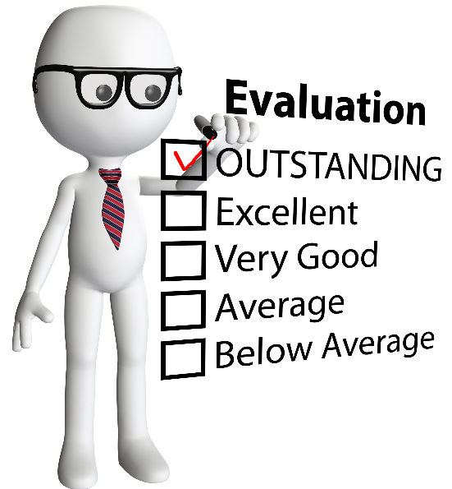
Suggestions For Evaluators

Slide 6
Before You Begin Evaluating
Outline specific criteria being relied upon to evaluate individuals.
Articulate specific results or behaviors that would demonstrate mastery of their job.
Use the same criteria for all employees at the same level.

Slide 7
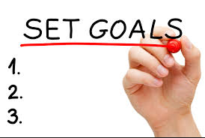
Draft a motion
Defend an expert deposition
Write an article for publication
Set a goal to discuss about three to five specific business outcomes with all employees.
Solicit input from employee or peers to provide outcomes to be measured by.

Slide 8
Tie Feedback To Goals & Outcomes
Systematically tie feedback — either positive or developmental — to goals and outcomes.
“You are effective at building team outcomes. You successfully resolved the divide between the engineering team and the product team on which features to prioritize in our last sprint, leading us to ship the product on time.”
“People like working with you.”
https://hbr.org/2016/04/research-vague-feedback-is-holding-women-back

Slide 9
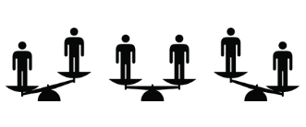
Equalize Feedback
When evaluating people in similar roles, equalize references to technical accomplishments and capability.
Strive to write reviews of similar lengths for all employees. This helps ensure a similar level of detail — and therefore of specifics — for everyone.
https://hbr.org/2016/04/research-vague-feedback-is-holding-women-back

Slide 10
Beware Of Pitfalls
Women tend to make the mistake of assuming that people will notice their good work and reward them for it.
https://www.ellevatenetwork.com/articles/6544-set-yourself-up-for-success-at-your-performance-review
Cartoon from: https://business.linkedin.com/talent-solutions/blog/talent-on-tap/2017/why-no-one-is-getting-the-annual-review-process-right-and-how-to-change-that

Slide 11
Reviews Should Be A Two-Way Conversation
Performance reviews would be more helpful if employees have the opportunity to weigh in and promote themselves (two way conversation).
Have all employees complete a self-review highlighting specific accomplishments achieved during the year.

Slide 12
Reduce Unconscious Bias
Tools such as Harvard’s Implicit Association Test¹ can show managers what biases they have.
To help reduce unconscious bias:
List the expectations and goals for a role, and stay consistent with that list during performance reviews.
Develop a Performance Review Checklist:
Positive feedback and constructive feedback, should each be supported with a specific example or business outcome.
Example: Reminding her of a project for which she missed a deadline because she failed to communicate allows her to examine the root cause and know what to do differently next time.
Similarly, positive feedback should be specific.
1. https://implicit.harvard.edu/implicit/takeatest.html

Slide 13
Train Managers To Give Constructive Feedback
Constructive feedback ≠ negative feedback.
The first rule of constructive feedback is to not go in without a plan and expected result.
A common fear with constructive feedback is that it will upset the employee. This ‘protective hesitation’ is a critical barrier in having conversations necessary to advance women’s careers.”³
1. https://www.linkedin.com/pulse/3-ways-avoid-giving-women-vague-feedback-performance-dani-fankhauser
2. https://hbr.org/2016/04/research-vague-feedback-is-holding-women-back
3. https://www.linkedin.com/pulse/3-ways-avoid-giving-women-vague-feedback-performance-dani-fankhauser

Slide 14
Suggestions For Those Being Evaluated

Slide 15
Be specific in your own self-evaluation. Include:
Specific examples of projects you are proud of;
Specific skills at which you excel;
How you have implemented those skills; and
Specific career goals that you have.

Slide 16
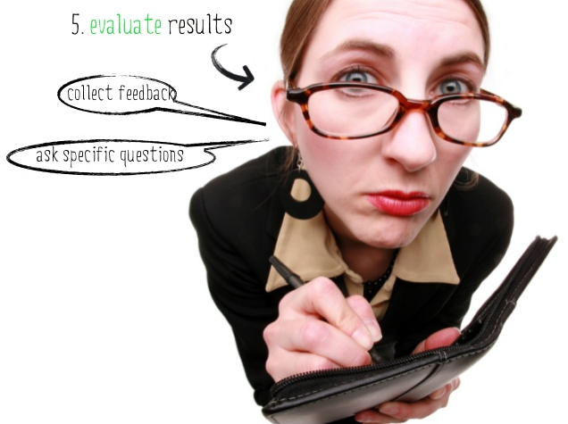
Be Proactive
Prior to annual evaluations, approach your supervisors and express interest in obtaining specific feedback in your evaluation.

Slide 17
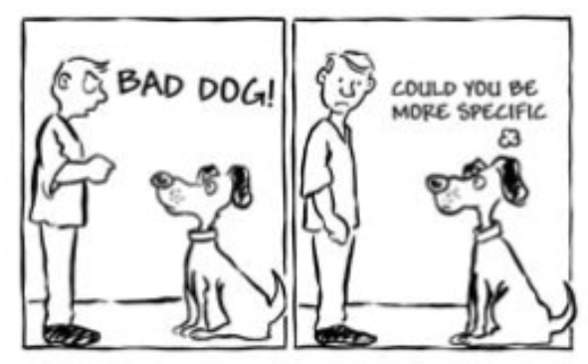
Request Specific Feedback
Ask for specific examples when given vague feedback. To avoid sounding defensive, offer something along the lines of “I really want to understand your feedback because I value it. Can you please provide some examples?”
Cartoon from: http://elt-connect.com/givingyourstudentsfeedback/

Slide 18
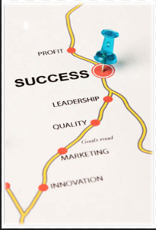
Clarify Expectations
Clarify expectations and get them in writing. If you want a promotion next year, work with your evaluator to determine exactly what you need to do to make that happen. This will provide a roadmap and will avoid vague feedback if you don’t get the promotion.

Slide 19
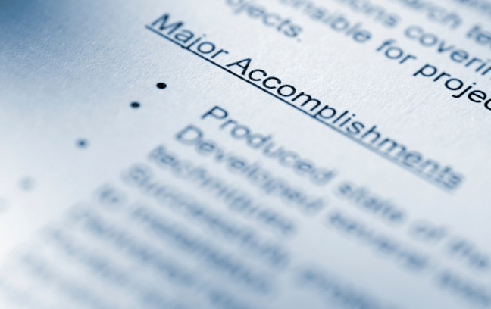
Maintain Records
Women tend to be promoted on accomplishments more than potential.
Maintain detailed records of what you have done and achieved to not miss any of your successes achieved throughout the year.

Slide 20
Questions?

Slide 21
Special Thanks
With special thanks to IPO’s Women in IP “Push Forward” Subcommittee Members who contributed to the content of this presentation:
Shruti Costales (Subcommittee Chair), HP Inc.
Emma Bienias, Stout Risius Ross
Margaret O’Boyle, O’Melveny & Myers
Rachael Rodman, Dinsmore
Lonnie Rosenwald, Intellectual Ventures
Leanne Rakers, Harness Dickey
Kelly McDow, The Procter & Gamble Company

